Slide 1
Assessing the utility of synthetic data: A density ratio perspective
Thom Benjamin Volker, Peter-Paul de Wolf & Erik-Jan van Kesteren
UNECE Expert Meeting on Statistical
Data Confidentiality

Slide 2
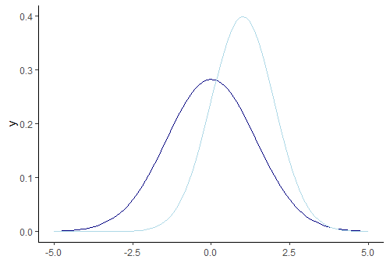
Synthetic data utility
Intuitively
How different are the synthetic data from to the observed data?
Is the synthetic data (almost) as useful as the observed data?
Practically
Can we tell the observed and synthetic data apart?
Can we obtain inferences from the synthetic data that are similar to inferences from the observed data?

Slide 3
Utility is hard to measure
The utility of synthetic data depends on what it’s used for
How can we know what the synthetic data will be used for? We can’t…
We need good measures for general utility (distributional similarity)
pMSE
Kullback-Leibler divergence
Notes:
Explain drawbacks of these methods: pMSE – very useful in practice, but how to specify a good model, especially when the dimensionality of the data increases?
KL divergence – theoretically very elegant, but hard to use/calculate in practice

Slide 4
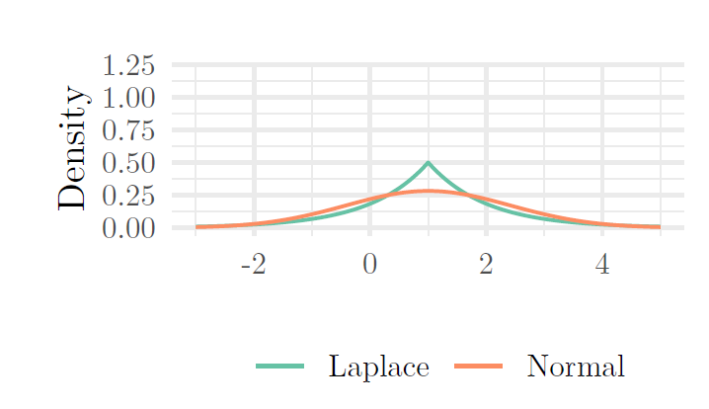
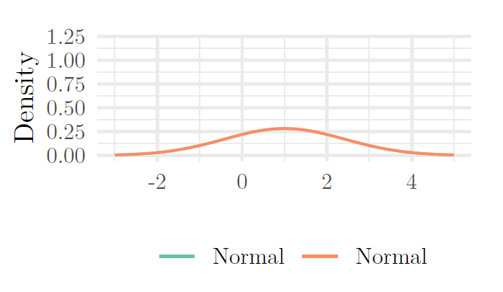

Evaluating utility: density ratios
Directly estimate the ratio of the densities of two samples: $r\left(x\right)=\frac{p_{syn}(x)}{p_{obs}(x)}$
Figures of the density ratio here

Slide 5
How to estimate a density ratio?
NOT: Estimate separate densities and take their ratio.
BUT: Estimate the density ratio directly.
Many methods exist:
Kernel-based (highly flexible, non-parametric)
Classification-based (pMSE-like)
Different loss functions
Density ratio estimation is not a method, it’s a framework!

Slide 6
Unconstrained Least-Squares Importance Fitting
ADD

Slide 7
Utility and privacy are opposites

Slide 8
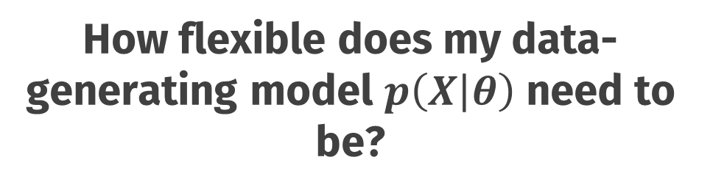
How flexible does my data-generating model $p\left(X | θ\right)$ need to be?
flexible
inflexible
Utility
Privacy

Slide 9
Conclusions

Slide 10
Default light slide
Default subheading
This is the body of the text
Default subheading
Note that the text is not black, but “black, text 1, lighter 25%”
Default subheading
This makes things easier on the eyes
Default subheading
This is the body of the text

Slide 11
Is this an impact slide?

Slide 12
Default light slide
This is the body of the text

Slide 13
Default dark slide
Default subheading
The dark slide brings some variation
Default subheading
It can highlight important aspects of the presentation.
Default subheading
This is the body of the text
Default subheading
This is the body of the text

Slide 14
Is this an impact slide?

Slide 15
Here is an impactful slide with a sentence on it.
Here is a topic related to the aforementioned question.

